Slide 1
TPO Network Awards
TPO Network Awards training
Ann Penistan
26 March, 2014
Crowne Plaza Hotel, Managua, Nicaragua

Slide 2
ITC@50

Slide 3
ITC’s programs aim at micro, meso and macro level clients.
To support Exporters, Policymakers & other TSIs

Slide 4
ITC works with TSIs, NGOs as well as with companies and ministries as multipliers.
For example, ITC partners with women’s associations, such as Weconnect (non-profit that support Women owned businesses to succeed in global value chains) on The Global Platform for Action on Sourcing From Women Vendors (buyer/sellers meeting)
TIS services provide information services to sectoral associations (e.g. leather, coffee etc sectors) to help with searching, processing and disseminating trade information and setting up information networks.
The institutional development initiative of the TS Section aims to work with not for profit national organizations mandated by the government to promote the country’s export strategy through offerings trade related support services to macro, meso and micro level audiences like other trade support institutions do. They are called the TPOs.

Slide 5
AIM for Results
an Integrated Approach to Institutional Strengthening
M₂
Assess
Improve
Measure
Modes of Delivery
Strategy and Management
Developing a Service Portfolio
Training
Benchmarking
Business Generation
Result and Impact Measurement
Advisory
Institutional Mapping
Networking
Information
Foreign Trade Representation
M₁
AIM Performance Improvement Roadmap
Notes:
2 – 3 year programme for TSIs.

Slide 6
Global TPO Network: A Network for learning through sharing
Why a network?
The Work
To pool resources and competencies to deliver services that meet the increasingly specific needs of the clients and to avoid duplication of efforts.
To share practices on business and management processes by participating in collecting, processing and disseminating them.
The Net
To build standardized systems and processes for gathering, processing and disseminating information on practices that can improve TPO business and management processes.
How
TPOs using online and offline platforms.
Notes:
The network can be vital to a TPOs health and well being. Sharing common issues and solutions.

Slide 7
Global TPO Network: A Network for learning through sharing
ITC’s TS Section is contributing to this effort through the Conference & Awards and the Benchmarking programme.
The awards gather information on the processes TPOs use to identify, design, develop, organise, deliver and measure their services.
The Benchmarking activities gather information in the areas of: Leadership and governance, resources and processes, product and service delivery and impact measurement.

Slide 8
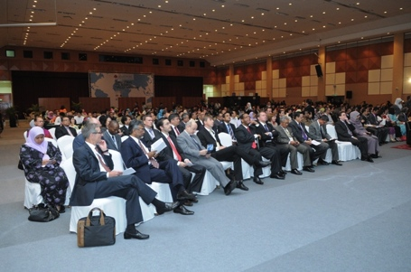
The TPO Network Conference and Awards
The TPO Network Conference is designed as a first step in providing a platform to foster discussion and debate on topical issues and innovative solutions while identifying and sharing innovative practices.

Slide 9
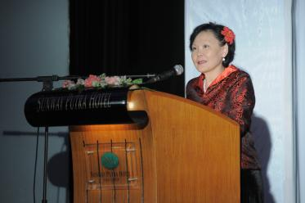
The Awards – Recognising outstanding performance
2004 – 2012 Winners
2004: Uganda, Korea, Australia, Jamaica, Bulgaria, Columbia
2006: Zambia, Finland, Mauritius, Mongolia, Chile,
2008: Afghanistan, New Zealand, Jamaica, Kenya, Costa Rica
2010: Mauritius, United Kingdom, Brazil;
2012: Uganda, Austria, Jamaica, Mexico

Slide 11
A NOTE ON ELIGIBILITY
The TPO Network Awards are open to all trade support institutions that are officially recognized as the national organization for trade promotion.
Depending on the country this function maybe performed by a Chambers of Commerce or a department within a related ministry or the national trade promotion organization.
Agencies which are not eligible for the awards, such as regional and provincial TPOs, active trade training organizations etc., can and do become members of the Global TPO network and benefit from the sharing of practices.

Slide 12
2014 TPO Network Conference & Awards
Dubai, United Arab Emirates
Hosted by Dubai Exports in partnership with ITC

Slide 13
THE TPO NETWORK AWARDS PROCESS AND THE SPECIFIC TOPICS FOR DISCUSSION TODAY
Prompting Applications
Developing Applications
Receiving applications
Application Processing
Announcement of Results
Follow-up
Call for applications
Invitation letters sent
Website announcement
Press releases Instructions for applying
Applicants develop their applications
Assistance provided:
Periodic awards training to TPOs for preparation of applications
FAQ and information desk available to respond to inquiries;
All TPOs provided with same information.
ITC receives and acknowledges applications;
Confirms eligibility for consideration by panel.
Eligible applications compiled and sent to panel for evaluation
Shortlist is announced;
Press releases
Final announcement/
Presentation ceremony
Press Releases, interviews
Publicity and promotional activities for winners : Practices developed with the winners for the booklet.
Practices may be further developed for sharing & implementation by other TPOs

Slide 14
Past and current adjudicating panel members
Mr. Oscar Gastellum, Exports projects coordinator, ProMexico
Ms Maria Paula Vellosa, Manager, Customer Relationship Management Apex-Brasil

