Slide 1
Session II
The benefits of the awards, the concept and structure; the application form and evaluation criteria
Ms Ann Penistan ITC
26 March, 2014
Crowne Plaza, Managua, Nicaragua

Slide 2
Purpose and benefits of the awards
The awards were established to recognize institutional excellence and encourage the sharing of best practices among national export promotion agencies.
ITC expands its library of good practices in the areas of designing, developing, delivering and assessing (DDDA) TPO services and disseminates them for the benefit of its TPO network
ITC records and analyzes what works and what doesn’t work, and under what circumstances for the benefit of its TPO network members .
ITC supports its benchmarking initiative by supplying a comprehensive set of good practices for sharing and adoption by other TPOs.
Participating TPOs Improve their DDDA of services by benefitting from the recognized good practices of others.
TPOs strengthen their strategic partnerships with other TSIs/TPOs and increase their credibility with beneficiaries and donors
Participating TPOs find new opportunities for collaboration with other institutions
Participation provides an opportunity to review the TPO’s own services objectively and improve its DDDA through reflection and innovation.

Slide 3
What did the participants say?
We wanted to build the standards used in our award winning export development initiative into our other services. So we re-structured our needs assessment questionnaires to gather more concise information.
We updated the processes of some of our development services according to the awards structure; and we revamped our measurement processes so that we could better track results to assess if the service had satisfied the unmet need we identified.
We made a commitment to present a good case…. selecting the project was a struggle as we didn’t have all the answers required in the application. This made us realise that there were gaps in our processes which needed attention.
The award has generated more interest from other trade promotion organizations in Africa – they want to see what others are doing. It spurs discussion because other TPOs ask us about what we did.

Slide 4
THE TPO NETWORK AWARDS
The TPO Network Awards focus on outstanding performance of the TPOs processes and practices in providing excellence in Export Development Initiatives.
The Awards aim to identify and recognize innovative processes that have successfully contributed to strengthening the competitiveness of exporting enterprises or have made a significant and positive change towards reaching this.

Slide 5
THE TPO NETWORK AWARDS PROCESS AND THE SPECIFIC TOPICS FOR DISCUSSION TODAY
Prompting Applications
Developing Applications
Receiving applications
Application Processing
Announcement of Results
Follow-up
Call for applications:
Invitation letters sent (post and email)
Website announcement
Press releases
Instructions for applying
Applicants develop their applications
Assistance provided:
Periodic awards training to TPOs for preparation of applications
FAQ and information desk available to respond to inquiries.
All TPOs provided with same information.
ITC receives and acknowledges applications;
Confirms eligibility for consideration by panel.
Eligible applications compiled and sent to panel for evaluation
Shortlist is announced:
Press release,
Website,
Email.
Final announcement:
Presentation ceremony,
Press releases, interviews
Publicity and promotional activities for winners: Practices developed with the winners for the booklet.
Practices may be further developed for sharing & implementation by other TPOs

Slide 6
The awards Taxonomy
Corporate Social
Responsibility
Initiatives
Communicating the
Products & Services
Export Promotion
Initiatives
Distribution of
Products & Services
Export Development
Initiatives
Service/Product Taxonomy
Marketing Taxonomy
Business Taxonomy
Notes:
HOW DID ITC STRUCTURE THE PRODUCTS AND SERVICES of the TPO?
To extract information in a standardized way, we needed to structure the products and services of the TPO. Services are classified according to their purpose and this helps the adjudicating panel assess like with like.
CSR: those initiatives that create awareness about CSR activities to the macro, meso and micro audiences. They do not have a commercial purpose and are measured as such; Examples are Environment, Equality at work, labour relations, occupational health and safety, poverty, etc.
Export development: services aimed to increase export competitiveness by building capacities to export – e.g. training programmes (e.g. training in strategy design to build capacities of SMEs to competitively enter a newly identified market; or on branding to build capacities to negotiate/charge higher prices when exporting.
Export Promotion Initiatives: Those services that are directly aimed to contribute to the growth of sustainable exports (bus gen initiatives such as buyer- seller meetings, trade fairs etc.); Some of these services have a component of export development in them.
Communications: builds awareness and sets expectations of the target audience about TPOs services; requires numerous processes, such as designing and launching promotional programmes to advertise services; audience is defined by strategy; media selection for target audience
Distribution: maximizes coverage and access to TPO services – could be done with through partners (with monitoring); also online, mail, help lines etc.
This structure/this classification of services allows the awards to open up to new categories on CSR, Export Promotion or Marketing processes in the future.

Slide 7
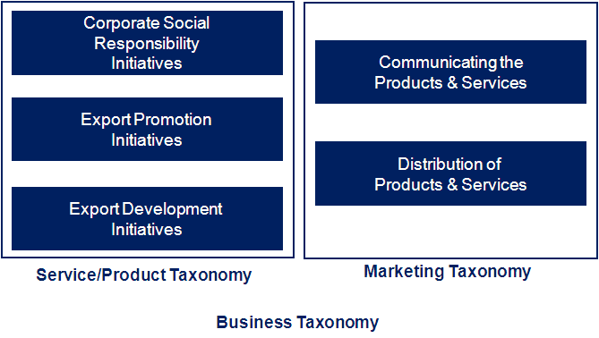

The focus of the current awards
Notes:
The Awards focus on Export Development initiatives.

Slide 8
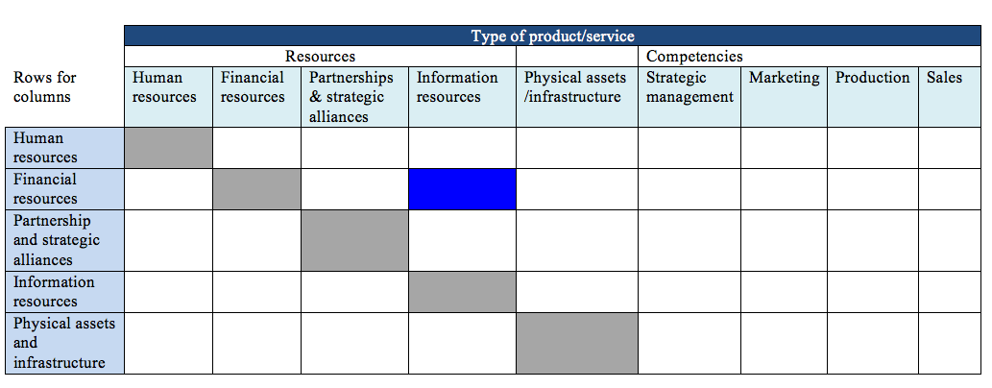
Export development services
Example: A TPO provides financial support under an initiative called: Supporting Market Research for Exporters. The TPO is authorized to select the firms to be funded under this scheme according to the guidelines prepared by the Ministry of Foreign Trade. The funds are withdrawn by the awarded company from the Central Bank.

Slide 9
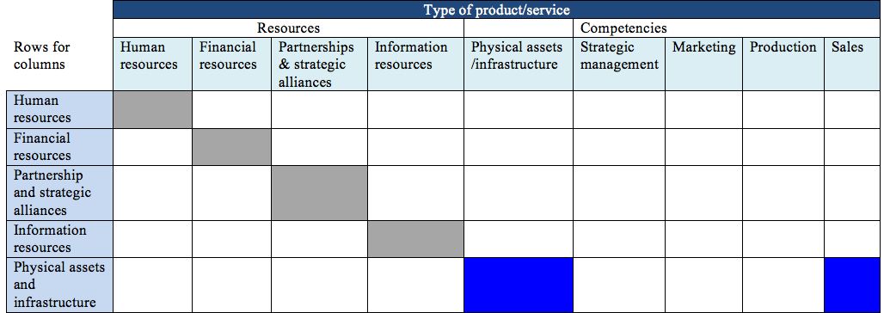
Export promotion services
Example: A National Association for Trade Fair Organization provides stands to companies at trade fairs. The initiative also includes a component on training concerning sales skills particularly on negotiations, pricing & quoting and sales contracts.

Slide 10
Identifying export development services
Training for Export
……….. organises seminars and workshops to nurture new exporters and update existing exporters on trade developments and business opportunities in international markets. The topics covered include export opportunities in specific markets and trade regimes, export procedures, developing brand names, products packaging, international marketing skills, e-commerce and trade documentation
Trade Advisory Help Desk
A Help Desk was set up at the Head Office to serve as the first point of contact for visitors who have enquiries on specific services and programmes of the TPO. The Help Desk also attends to phone-in enquiries from both the local and overseas business community, and where required, will forward the enquiry to relevant departments within or outside the organisation for follow-up action.
Briefing & Consultation
As part of ……… on-going efforts to improve its delivery system and to reach out to companies outside the ……Valley, a series of briefing and consultation sessions were organized. These sessions serve as a platform for the exporting community to provide feedback on export related issues and programmes and activities.
Notes:
Which of these describes an export development service offer?
1- Yes – most likely – but not in all areas. Part of this is information provision but it is unclear what is expected from the SMEs once they have the information.
Developing brand names (to charge more), improving packaging processes etc. are all export development initiatives.
2. No – this is part of a prompting and responding to enquiries which the TPO should have in place. It could not measure the improved capacity of an SME through the information provided at this stage.
3. No - this is part of the TPO’s processes to gather client feedback on its products and services, etc. There is no expectation that an SME would implement changes to improve its export capacity.

Slide 11
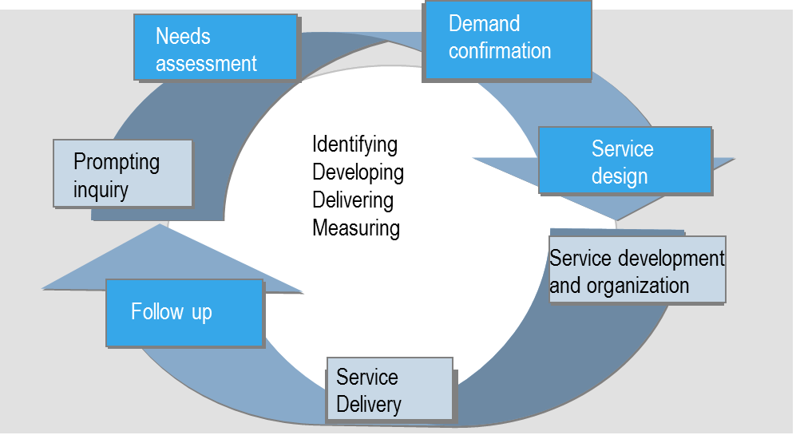
Export development initiatives

Slide 12
Evaluation criteria
Overview of the initiative (aim, features, purpose, target clientele, design, development and delivery)
Determining the need for the initiative (page 8)
Confirming the alignment of the Export Development Initiative with
the overall strategy of the TPO (page 9)
Performance monitoring of the initiative (page 10)
The demonstrated effectiveness of the initiative (page 10)

Slide 13
Needs assessment
Delineating needs, wants and demand
Ex: SMEs want low cost financial resources however, they need to improve their supply chain management but do not demand training.
Delineating institutional needs from needs of individuals.
Ex: The institution needs to upgrade its out dated production facilities and processes by getting a new machine; but its managers need knowledge on preparing feasibility studies for financing capital investments.
Institutions need resources and competencies to produce, communicate, distribute and sell its products and services.
Individuals need skills, knowledge, and the right attitude, along with training and tools.

Slide 14
Needs assessment: Gap Analysis
What needs to be described?
A gap exists when a need is not met. Therefore the awards application asks for a description of the processes used to find the gap the proposed initiative aims to fill:
Processes to:
Gather information on the competitive or complementary initiatives provided by others;
Assess the market usage and client satisfaction of those initiatives to identify the unmet need(s),
Identify the needs of the client and verify the demand.

Slide 15
Needs assessment
Determining the need/demand for the initiative
WHAT WILL THE ADJUDICATING PANEL BE LOOKING FOR?
A description of the processes that:
Is comprehensive and demonstrates that it is innovative and well designed;
Demonstrates how the results of this process are used to identify an unmet need and want of the target clientele;
Shows that the process is used systematically and periodically to verify that the initiative continues to meet the specified need over time.

Slide 16
Service design
Confirming the alignment of the initiative with the overall strategy of the TPO
Each service contributes to the overall strategic goals of the TPO.
To do this, each service must be compatible with the overall positioning and segmentation decisions of the TPO.
As such TPO need processes to derive specific service descriptions from its overall strategy so they are compatible with the positioning and segmentation decisions of the organisation.

Slide 17
Service design
Confirming the alignment of the initiative with the overall strategy of the TPO
WHAT NEEDS TO BE DESCRIBED?
The processes used to:
Communicate the strategy;
Verify that the targeted markets/segments align with the overall segmentation decisions of the TPO;
Verify the features of the initiative align with the overall positioning decisions of the TPO;
Monitor that the design, production, marketing and delivery align with overall goals of the TPO.

Slide 18
Service design
Confirming the alignment of the initiative with the overall strategy of the TPO
WHAT WILL THE ADJUDICATING PANEL BE LOOKING FOR?
A description of the processes that:
Show depth and clarity and can demonstrate innovation;
Demonstrates it is used systematically; evidence of periodic review, particularly when the initiative is updated/improved;
How the goals of the initiative contribue to the strategic goals of the organisation.

Slide 19
Service design
Confirming the alignment of the initiative with the overall strategy of the TPO
WHAT WILL THE ADJUDICATING PANEL BE LOOKING FOR?
A description of the processes that:
Show depth and clarity and can demonstrate innovation;
Demonstrates it is used systematically; evidence of periodic review, particularly when the initiative is updated/improved;
How the goals of the initiative contribue to the strategic goals of the organisation.

Slide 20
A note on measurement before we go into follow-up
Measurement
Ex: Using a test to measure how much the participants have learned how to prepare export documents.
Assessment
Ex: Tests show that 90% of the participants scored higher than 90 points and a 40% improvement over before the results achieved before the seminar.
Evaluation
Ex: Business losses resulting from errors in export documentation has dropped 30% within 6 months.

Slide 21
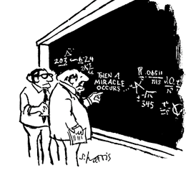
Tracking what happens

Slide 22
Follow up
Performance monitoring of the initiative
Initiatives are designed to meet an unmet need by aiming to strengthen the skills and knowledge and improve attitudes of the managers in specific areas to improve the competitiveness of SMEs;
Therefore a TPO must know if the initiative is satisfying that need.
They determine this by designing, installing and systematically utilizing monitoring systems (beyond assessing clients’ satisfaction) to identify and measure the outcomes and impact of the initiative and provide sufficient information on what is and is not working to upgrade the initiative and meet goals.

Slide 23
Follow up
Performance monitoring of the initiative
WHAT NEEDS TO BE DESCRIBED?
The processes used to gather, record, confirm and analyse the results and how the information was used for future improvement.

Slide 24
Follow up
Performance monitoring of the initiative
3 months
6 to 12 months
12 to 18 months
18 to 36 months
Immediate Outcomes
Intermediate Outcomes
Final Outcome
Intermediate Impact
Final Impact
Client Satisfaction
Favorable Client
Reactions towards the
institution and service
Awareness created
Attitude Change
Intent to Change
behaviour as expected
Behavioral Change
in how, or with what
means the beneficiary
has changed
Sustainable
Enterprise
Competitiveness
/Improved level)
Sustainable Exports of
Targeted SMEs
The outcome - impact chain

Slide 25
Follow up
Performance monitoring of the initiative
WHAT NEEDS TO BE DESCRIBED?
A description of the processes that show the TPO:
Measures the changes in awareness, attitude, and managerial practices of the beneficiaries through surveys, reports, questionnaires and other organizational mechanisms.
Measures the changes in the competitiveness of the beneficiaries as indicated by “more and more profitable exports with more favourable negotiated deals”.
Records and analyzes the data collected in order to evaluate whether the changes observed align with the expected results of the export development service.
Uses the results of the analyses to review and refine as needed the initiative submitted for evaluation to optimise its results and impact.

Slide 26
Follow up
Effectiveness of the initiative
WHAT WILL THE ADJUDICATING PANEL BE LOOKING FOR?
Evidence of the degree to which the initiative has directly built or enhanced the competitiveness of the recipients;
and/ or has achieved the expected behavioural changes that lead to it.

Slide 27
Follow up
Effectiveness of the initiative
Evidence that due to the export development initiative beneficiaries can now:
Negotiate better deals with their buyers to export, or export more, and more profitably by competing or by finding markets where competition is not strong;
Successfully use the features of their exports other than price (quality, timing, physical attributes, value added and amounts) to win buyers over;
Improve their profit margins.

Slide 28
Follow up
Effectiveness of the initiative
WHAT WILL THE ADJUDICATING PANEL BE LOOKING FOR?
EVIDENCE
The evidence that the export development initiative significantly contributed to the changes that are important in building enterprise competitiveness.
Specifically, although the changes that are deemed as contributors to this objective come in the form of awareness, attitude and behavioural change, panellists are looking for the positive changes in specific managerial and business practices that had been identified as factors working against enterprise competitiveness.

Slide 29
Exercise
The Pannonia Wine Project
What evidence is there that this is an export development initiative?
From the evaluation criteria, what is missing in this application?

Slide 30
Session III
Developing a comprehensive application and adhering to the guidelines

Slide 31
Presentation of the application
Parts 1 & 2
Contact Information & The Certificate
Part 3
Cover page: Optional
Executive Summary
Overview of the initiative (page 8)
Determining the need for the initiative (page 8)
Confirming the alignment of the export development initiative with the overall strategy of the TPO (page 9);
Performance monitoring of the initiative (page 10).
The demonstrated effectiveness of the initiative (page 10);

Slide 32
Format of the application
7 double-sided pages (a total of 13 pages)
Your submission must be written in English and formatted according to the following guidelines:
Font: Arial, 11, Black;
Titles in document: Bold;
Main titles/headers: Arial 12, bold;
Line Spacing: 1.5;
Margins, all: 2.54 cm;
Length: 7 pages double-sided maximum (applications exceeding 13 sides will be disqualified.

Slide 33

10th TPO Network World Conference and Awards
3 - 5 November, 2014
Dubai, United Arab Emirates
Hosted by Dubai Exports in partnership with ITC

